Slide 1
Call centre assignment Part 1
For Top Mentor
Sadhana R

Slide 2
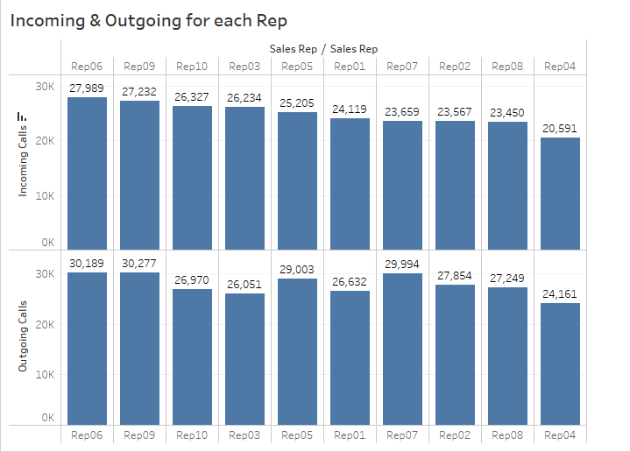

Slide 3
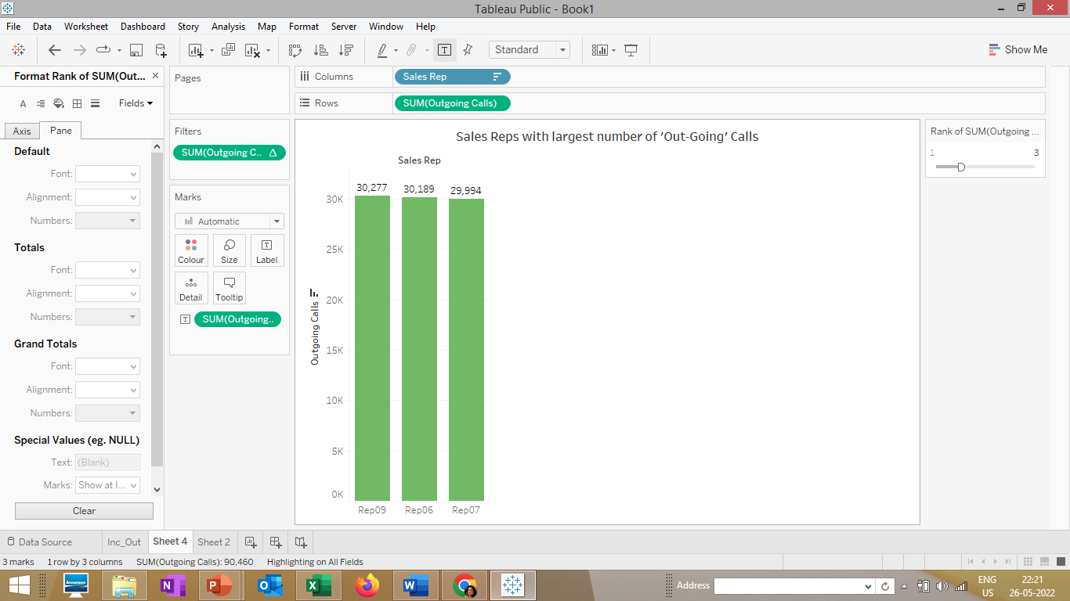
Top 3 Sales Reps with largest Number of Out-going calls

Slide 4
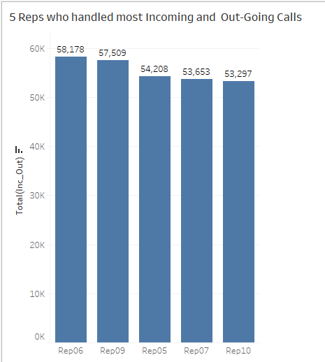

Slide 5
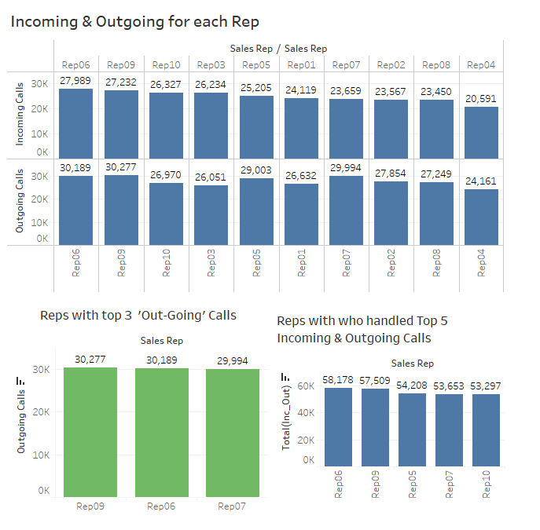

Slide 6
Call centre assignment Part 2
a) Make each sheet of different Sales Reps and identify the key KPI's and Charts to visualise as a story.

Slide 7
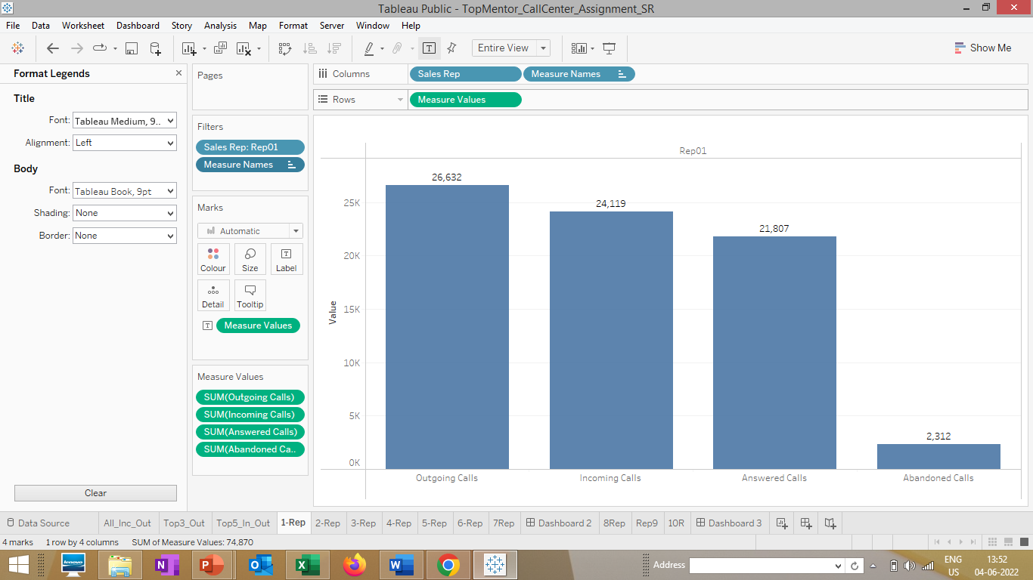
Rep 1

Slide 8
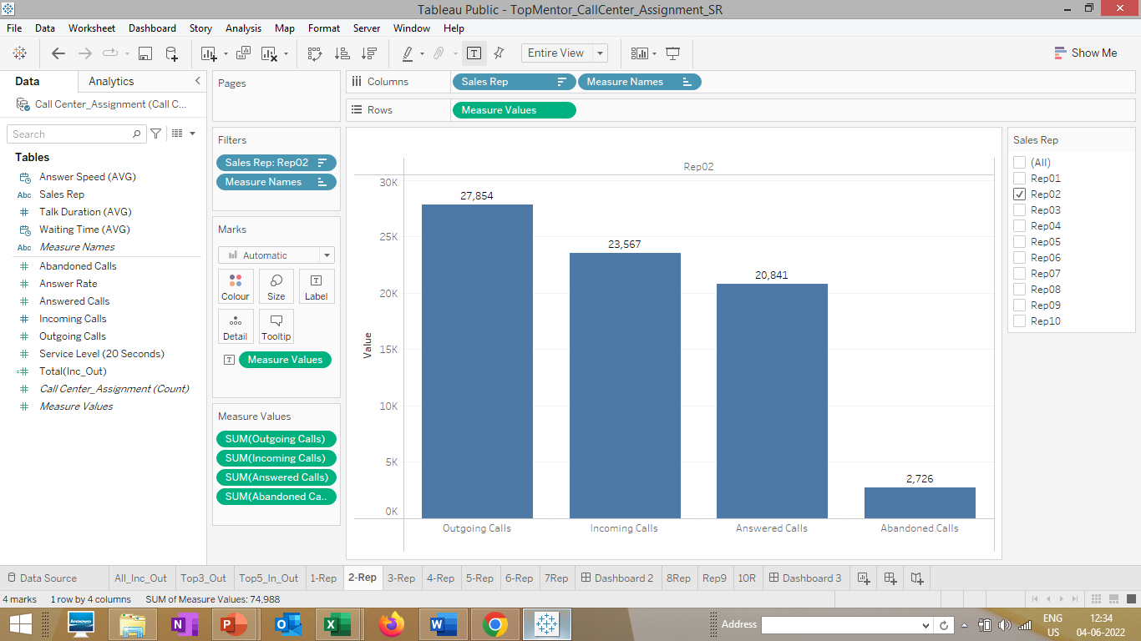
Rep 2

Slide 9
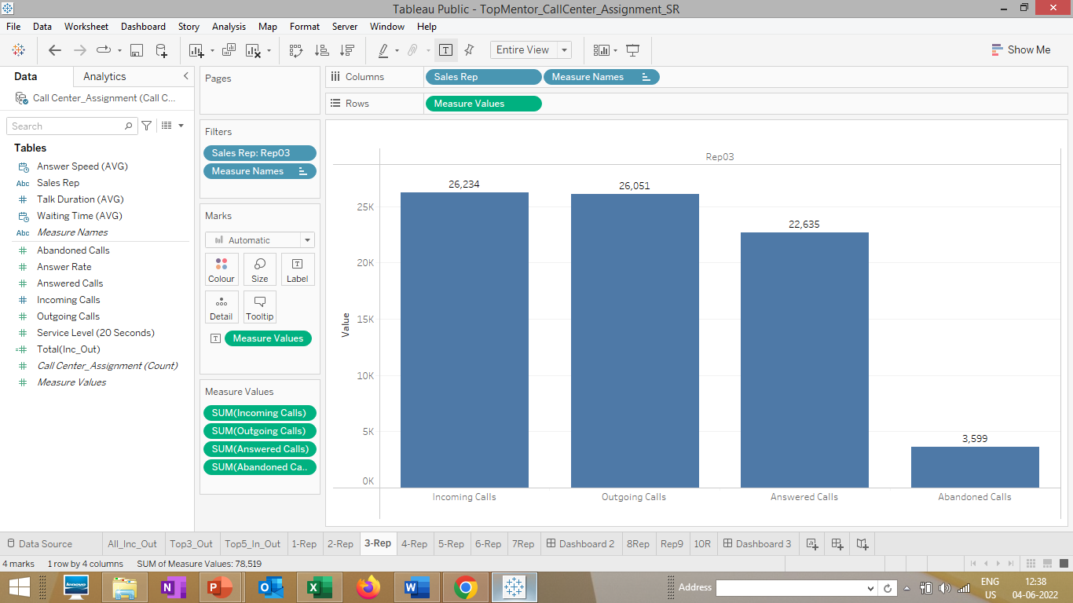
Rep 3 has highest number of abandoned call.

Slide 10
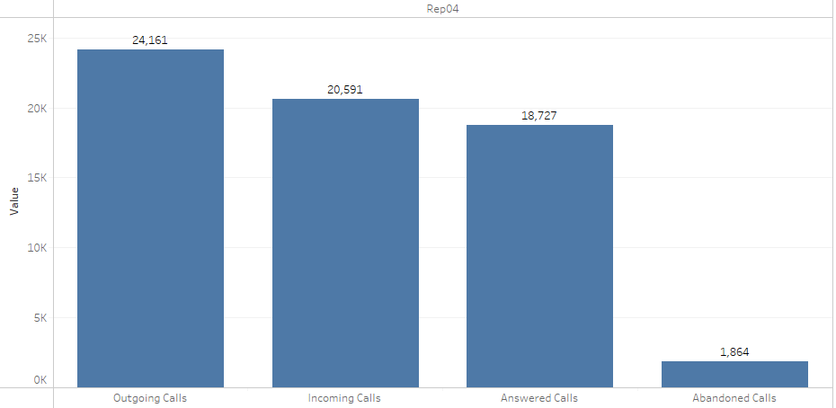
Rep 4
Rep 4 has picked lowest of Incoming calls

Slide 11
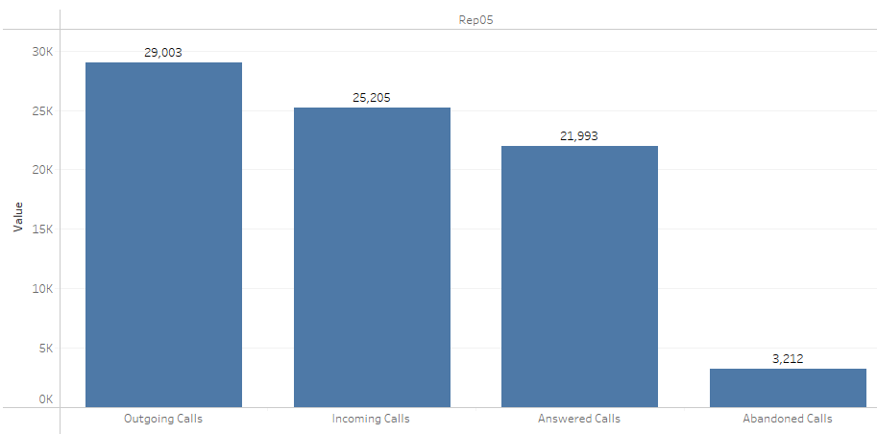
Rep5 recorded 2nd highest number of abandoned calls indicate, there is too much waiting time.

Slide 12
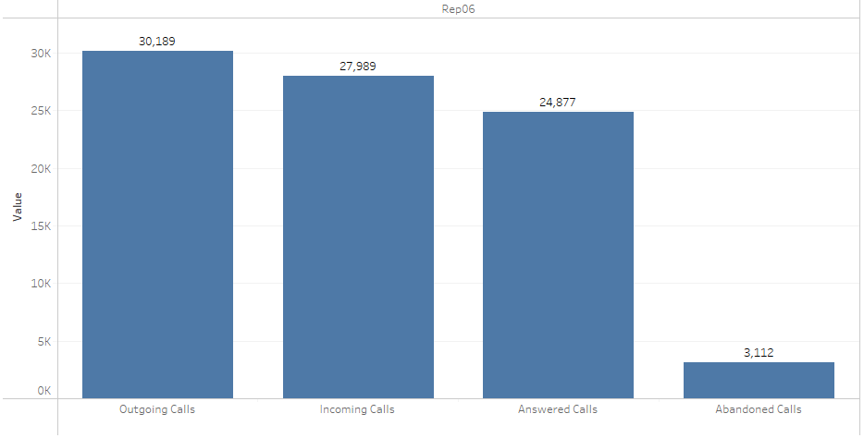
Rep 6 – has recorded highest number of Incoming calls, and 2nd highest outgoing calls. Highest in answering calls.

Slide 13
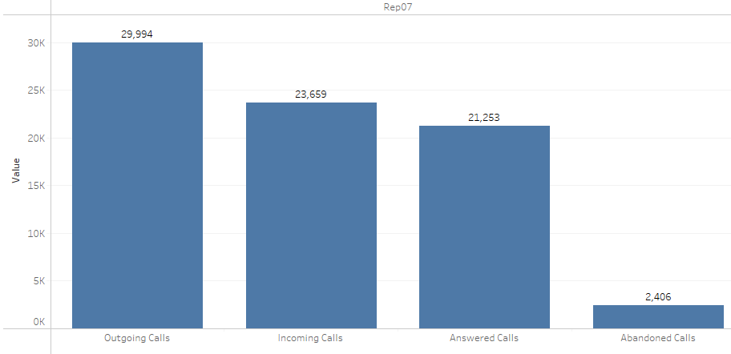
Rep 7 – has recorded 3rd highest number of Outgoing

Slide 14
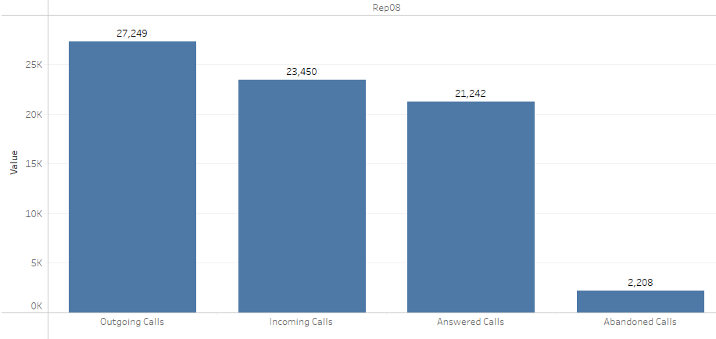
Rep 8

Slide 15
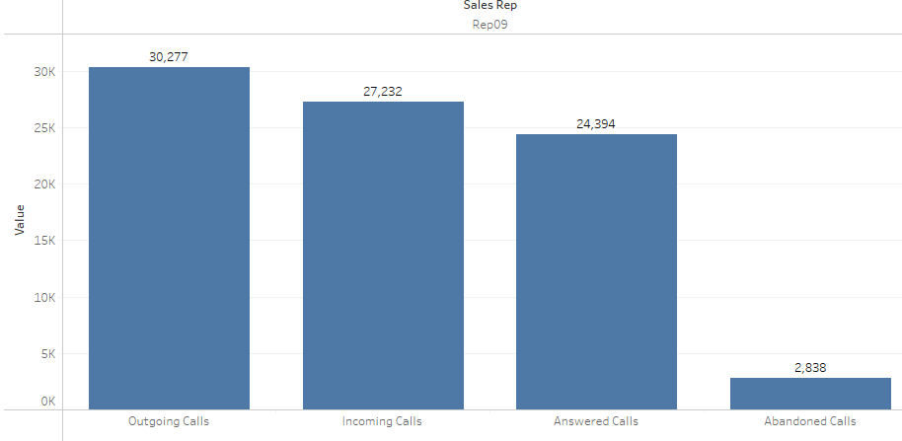
Rep 9 has recorded highest outgoing calls, 2nd highest incoming calls. 2nd highest in answering calls, next to Rep 6.

Slide 16
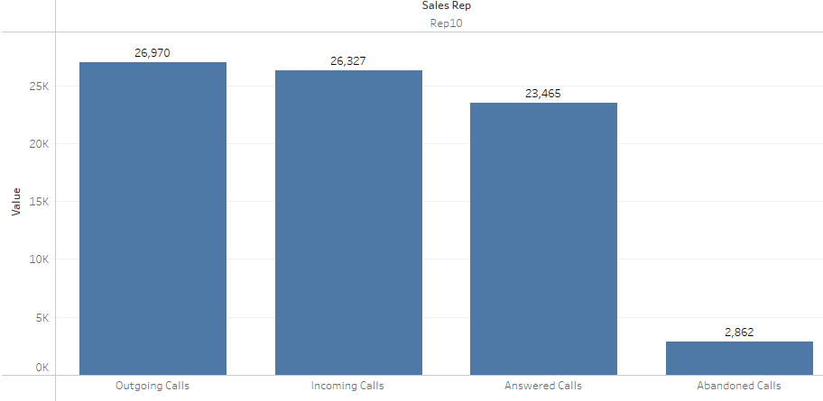
Rep 10

